Slide 1
Experiment
Proposed method validated using 2 datasets sourced from Flickr.
First set called MERGED- 9,469 images from three different landmarks- Fontana di Trevi in Rome, the Duomo in Milan and the Old Town Square in Prague.
Second set called Rome-13,049 images depicting several famous landmarks of Rome (Colosseum, St. Peter’s Basilica, Fontana di Trevi, Pantheon, etc.)

Slide 2
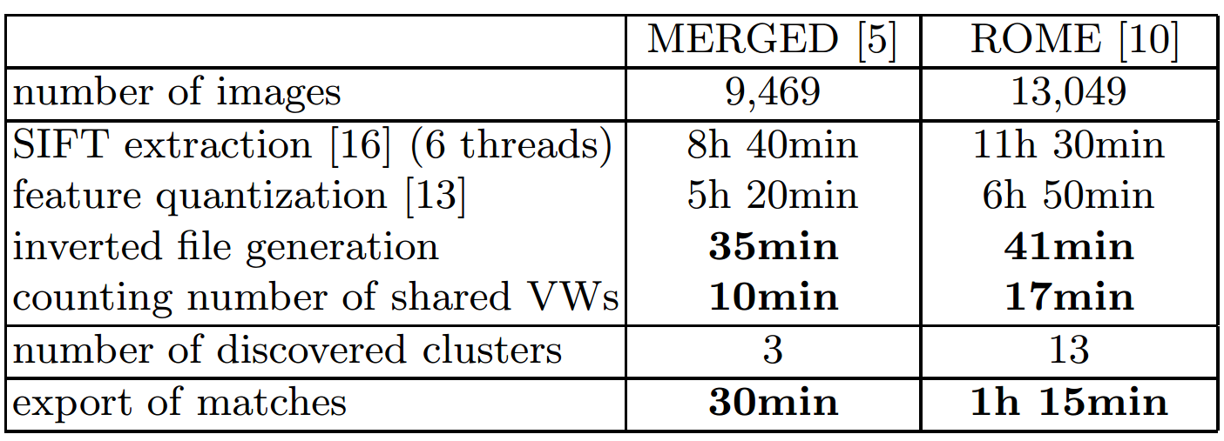
Considerations
All images are resampled to a size of ≈ 3 MP.
MERGED- raw result of searching Flickr with text tags.
ROME- Contains only images that were connected to a 3D model for which SfM computation already succeeded once.
Notes:
The more realistic situation is the one without pre-filtering, where the matching and clustering must also cope with unusable and unrelated images, as in the MERGED set. Still we also test on the ROME data, which it is more widely known and used, in order to better put our method into context.
Computation times measured on a standard desktop machine (Intel(R) Core(TM) i7-3930K with 24 GB of RAM) running 64bit Linux
SIFT extraction would need to be performed by any feature-based SfM method,
Feature quantization is needed by any methods that involves bag-of-words signatures .
The actual time needed to generate tracks is less than 1 hour for both datasets. Exporting two-view matches takes about as long as track generation.

Slide 3
Feature Extraction
Extraction of Hessian-affine interest points in all input images.
Conversion into SIFT descriptors.
Quantization against the 2-layer (4,096×4,096) visual vocabulary with ANN search using FLANN.
SIFT extraction running in 6 threads.
All other steps single-threaded and implemented in MATLAB.

Slide 4
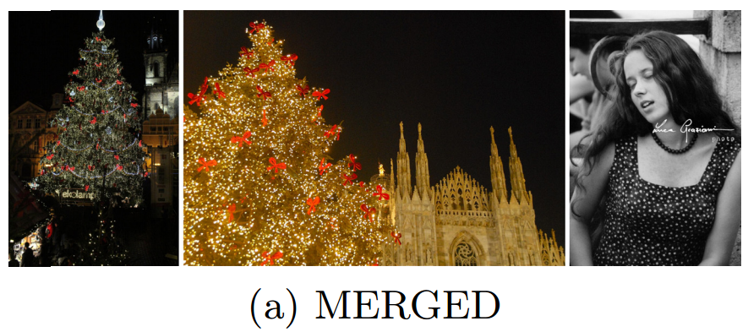
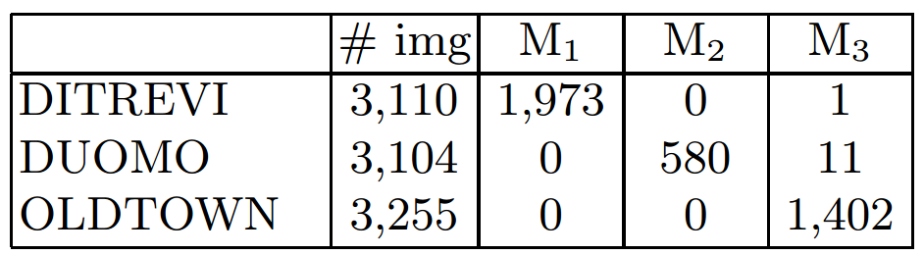
Clustering
1.) MERGED
Generated clusters considered clean by visual inspection.
Contain fewer images as unrelated images are filtered out.
12 wrong instances.
Notes:
Regarding confusions between clusters, only 12 images are assigned to the wrong cluster. None of these mistakes are specific to the proposed vocabulary-based matching: the 11 images from DUOMO are due to similarly decorated Christmas trees present at both locations. The 1 failure image from DITREVI is due to a dotted dress, which also matches the Christmas trees, see Figure 4a. All 12 images are later removed during SfM computation
The reason for the low number of images in M2 is a technical issue: the relevant DUOMO images are actually made up of three only weakly connected subclusters for the front facade, the inside and the roof. These are indeed recovered separately, but only the one for the front facade is large enough to be exported (≥ 100 images).

Slide 5
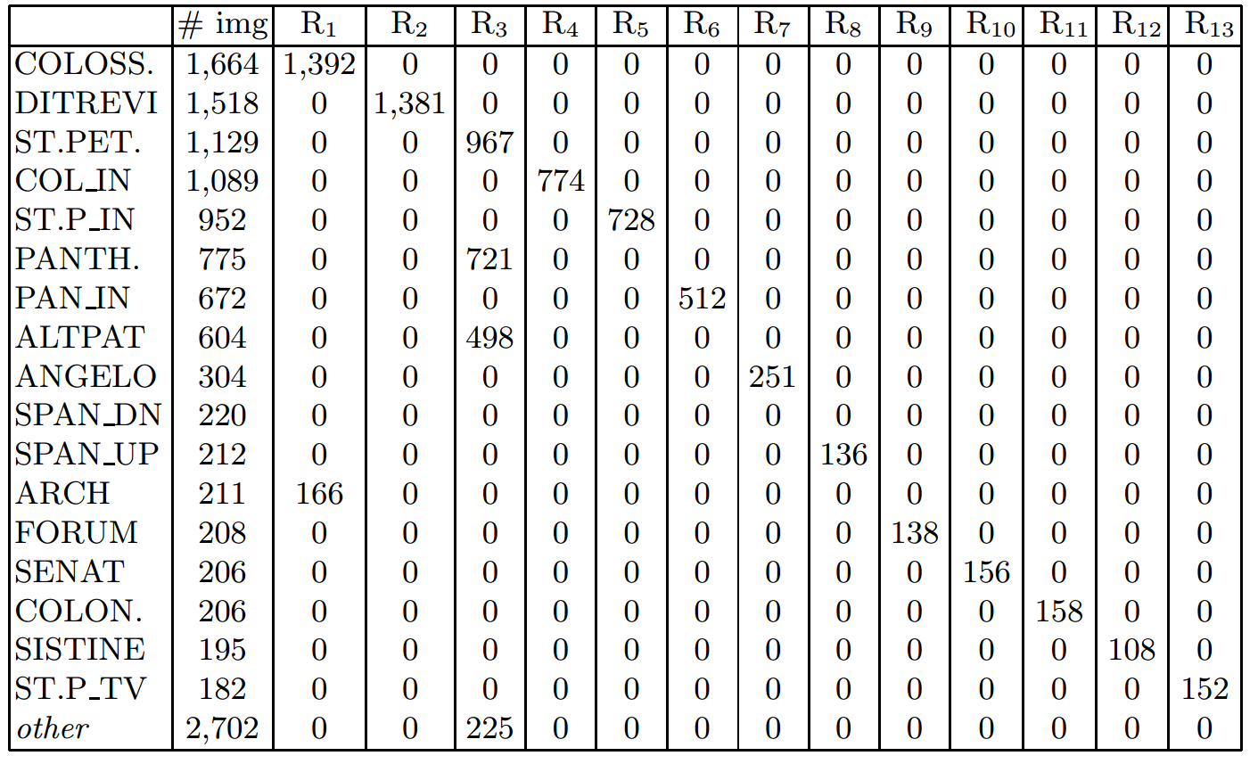
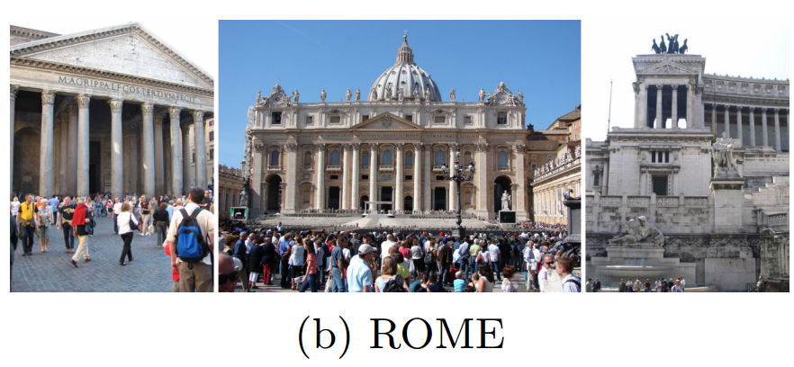
Clustering
2.) ROME
Division into individual 3D models.
Recovered clusters are clean w.r.t. the ground truth grouping.
Notes:
In R1 our clustering corrects the ground truth: the Constantine ARCH and the outside of COLOSSEUM are located near each other and can in fact be reconstructed into a connected 3D model.
R3 is an actual failure case, where multiple sites (the front of St. Peter’s Basilica, the front of the Pantheon, and the Altare della Patria) are mixed, because the images are dominated by similar column structures,
Since for the ROME dataset clean ground truth clusters without unrelated clutter are given we could also check the completeness of our clustering. On average, > 77% of all images were found for a given landmark. Overall, the quality of clustering is more than satisfactory, considering the fact that it was performed without any geometric verification.

Slide 6
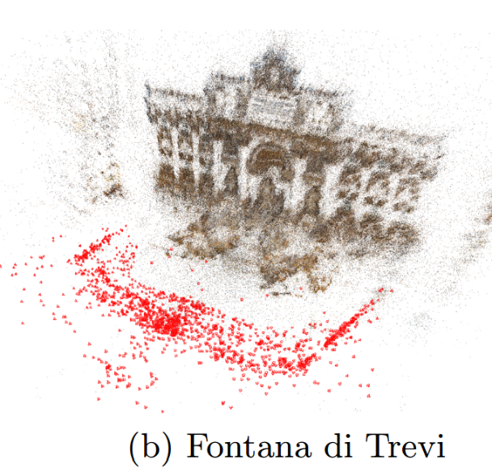
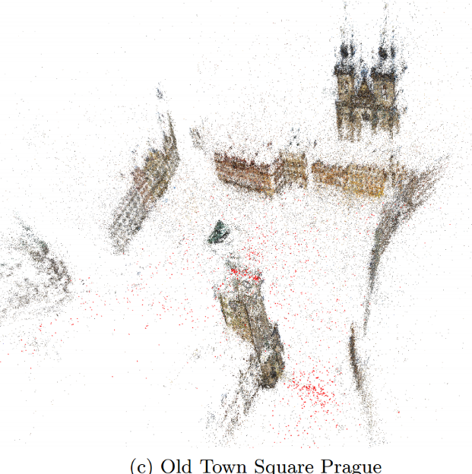
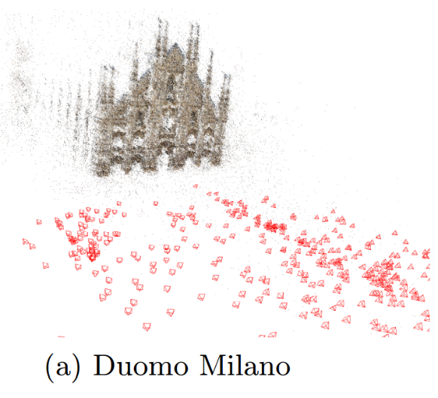
Export of Matches and 3D Reconstruction
Exporting matches for each cluster.
Bundler called with default settings to perform sparse 3D reconstruction.
Notes:
Almost all relevant images from a cluster could be oriented in most cases.
Inlier fraction of the proposed vocabulary-based matching is high enough to successfully RANSAC correct epipolar geometries.
Estimated camera poses are denoted by red pyramids.

Slide 7
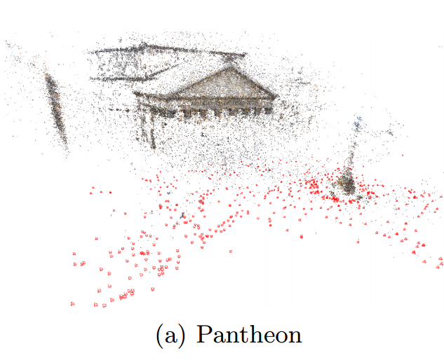
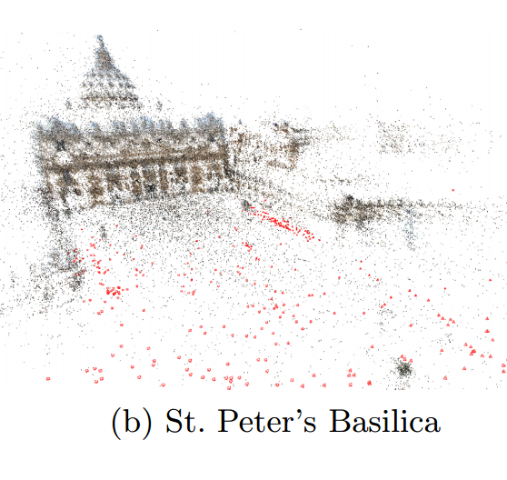
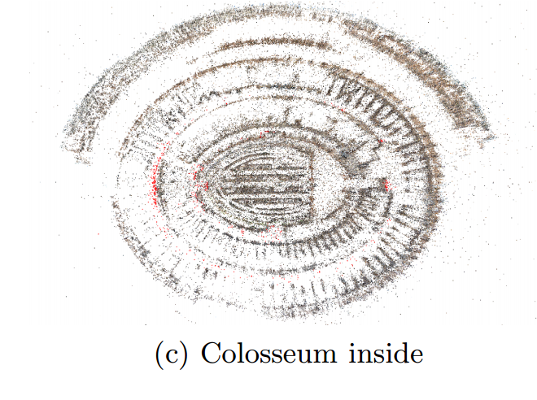
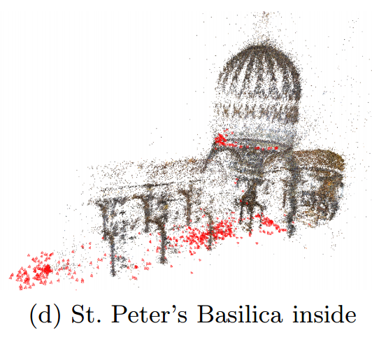
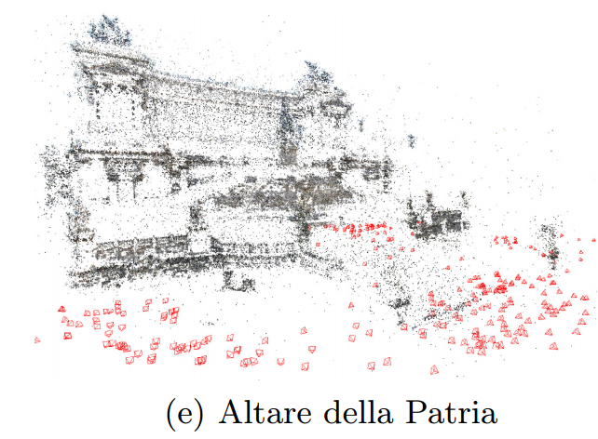
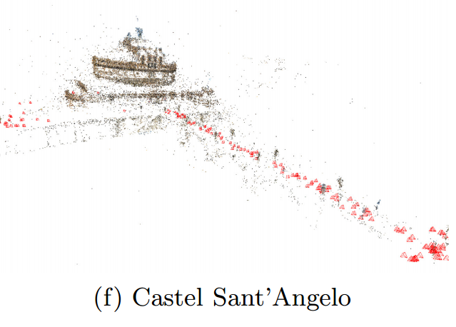
Notes:
The worst failure is that for PANTHEON 20% of the images, which show the inside of the building, could not be connected.

Slide 8
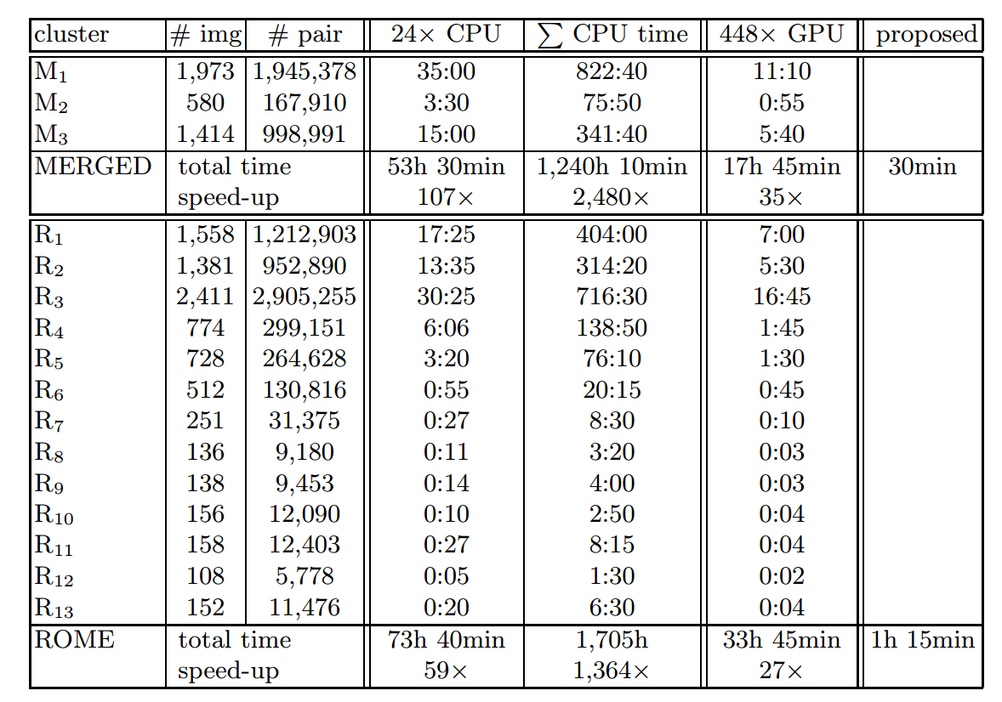
Computation Comparison
Standard pairwise ANN matching (Bundler default) performed in each image cluster as baseline.
Notes:
Time needed for exhaustive pairwise matching within the clusters (in hours). Three methods are compared: multi-threaded ANN CPU matching, SiftGPU (CUDAenabled GPU matching), and the proposed method. For the first two methods matching all image pairs without prior clustering would take orders of magnitude longer.
As expected, the running time is orders of magnitude longer, even if the matching is parallelized in 24 threads,
state-of-the-art CUDA-enabled SiftGPU matching from VisualSFM for a slightly smaller number of SIFT features was not much faster than the multi-threaded CPU matching either,
the proposed method—export of matches from the inverted file—is still roughly 30× faster.

Slide 9
Quality Comparison
Same number of correct camera poses are reconstructed with both methods.
Full pairwise matching generates twice as many matches as the vocabulary-based method yet approximately the same number of 3D structure points.
Vocabulary-based point clouds are a bit noisier.
Notes:
1. For most applications this is the most important quality criterion. In localization/navigation-type applications the camera pose is the immediate goal.
If the goal is 3D object modeling then SfM also serves mainly to recover the camera poses, since the final model is constructed in a subsequent step with some form of dense matching or 3D surface reconstruction.
2. Vocabulary-based matching is stricter and cannot always find the complete track for an object point. This is in all likelihood also the reason why Bundler took significantly longer to construct the 3D models from conventional pairwise matches.
3. Means that the correspondences detected with the proposed method are either not quite as accurate, or that they contain more epipolar-consistent miss-matches. The lower accuracy is somewhat expected, since shorter tracks mean fewer rays per point and thus higher uncertainty of the triangulation.
Also in Internet photo collections many images are typically taken from the same height with similar viewing direction, e.g. viewing the front side of a monument from street level. Under that viewing geometry repetitive or diffuse appearance along the (horizontal) epipolar lines can lead to miss-matches.
****Such matches will be rejected by the 2nd-best ratio test in standard SIFT matching, but the vocabulary-based approach includes no such test.

Slide 10
Conclusions
Multiview correspondence efficiently established using only visual words that appear at most once in every image.
Feature track generation steps with proposed VocMatch methods are all linear in the size of the image set.
Integration into SfM incremental quadratic.
Scalability- Infeasible for 1,000,000 images due to impossible memory requirements.
Notes:
What makes the proposed method practical is the realization that today’s visual vocabularies are large enough to ensure that, even in datasets > 10,000 images, the overwhelming majority of all words are in fact unique in all images they appear in.
Interest point extraction, (ii) feature quantization against a fixed vocabulary, and (iii) inverted file generation.
The additional steps needed to integrate the method with incremental SfM, namely (iv) clustering based on match counts and (v) export of two-view matches are still quadratic. But they involve only very simple operations and in practice are orders of magnitude faster than full ANN matching.
Regarding scalability of the proposed approach, for 100,000 images with 10,000 features per image, the inverted file would take 6 GB of RAM (6 bytes per feature) and the clustering matrix Q would take 10 GB (2 bytes per image pair). Extrapolating the measured times, inverted file generation would take 6 hours (linear in the total number of features) and generation of Q 16 hours (quadratic in the track length) using a single thread, which are still very competitive times. For 1,000,000 images the method is currently not feasible, storing matrix Q in RAM would be impossible (1 TB).
****An open question is when a vocabulary becomes too large to be useful for matching. It seems clear that a too fine quantization will cause tracks to become fragmented, or lost altogether. We did not experience problems in our experiments, but note that the critical size is also dependent on the dataset: image sets with few interest points or weak connectivity are more vulnerable to a loss of correspondences. To counter the problem it might be possible to exploit the similarity between different visual words, either by direct comparison or by analyzing the descriptors they were trained on, and augment the vocabulary with neighborhood information. This could potentially allow one to also match descriptors if they do not quantize to the exact same visual word.

